Slide 1


Exploratory Data Analysis Project
Atria university Summer internship 2024
Exploratory data analysis using climate trace and google earth engine leading to earthstack

Slide 2



Introduction
The Objective: To explore and analyze the greenhouse gas emissions over different sectors along the years 2015 - 2022, to uncover patterns, trends, and insights.
Data Sources: Climate TRACE (https://climatetrace.org/) And google earth engine (https://earthengine.google.com/)

Slide 3



What is the data we are looking at?
We build a program that uses this available raw data and filters out and does necessary math to get our desired outputs for the environmental profile of the specified geographical area.
This data is collected from different providers - satellites, private organizations, etc., to create a publicly available place for people to view such factors that account for a given geographical area.
We try to get an environmental profile of a given area - where we can deduce the biodiversity, greenhouse emissions, water quality, forestry land use, etc. from the available datasets.
Now with all the outputs, we can make improvements to each area with the factor that they are lacking in (reasonably).

Slide 4
Climate trace
Using data on climate trace and performing eda.
Notes:
Data available on climate trace is restricted to greenhouse gas emissions and to the year range – 2015 to 2022, although we can further incorporate it in with some other source, since climate trace takes data to a much deeper (entity) level data, it would be hard to get balance in our findings.

Slide 5

Sector mapping
Agriculture: Cropland fires, Enteric fermentation cattle feedlot, Enteric fermentation cattle pasture, Enteric fermentation other, Manure left on pasture cattle, Manure management cattle feedlot, Manure management other, Other agricultural soil emissions, Rice cultivation, Synthetic fertilizer application
Buildings: Residential and commercial onsite fuel usage, Other onsite fuel usage
Fluorinated Gases: Fluorinated gases
Fossil Fuel Operations: Coal mining, Oil and gas production and transport, Oil and gas refining, Other fossil fuel operations, Solid fuel transformation
Forestry and Land Use: Shrubgrass fires, Removals, Forest land fires, Wetland fires, Forest land degradation, Net shrub-grass, Forest land clearing, Net forest land, Net wetland, Water reservoirs
Manufacturing: Aluminum, Steel, Cement, Petrochemicals, Chemicals, Other manufacturing, Pulp and paper
Mineral Extraction: Bauxite mining, Copper mining, Iron mining, Rock quarrying, Sand quarrying
Power: Electricity generation, Other energy use
Transportation: Domestic aviation, Domestic shipping, International aviation, International shipping, Other transport, Railways, Road transportation
Waste: Biological treatment of solid waste and biogenic, Incineration and open burning of waste, Solid waste disposal, Wastewater treatment and discharge
Notes:
This slide shows the sector mapping for the data available on climate trace, we had to accurately map each subsector to its corresponding sector so that we can get the most accurate data values for the emissions profile.

Slide 6
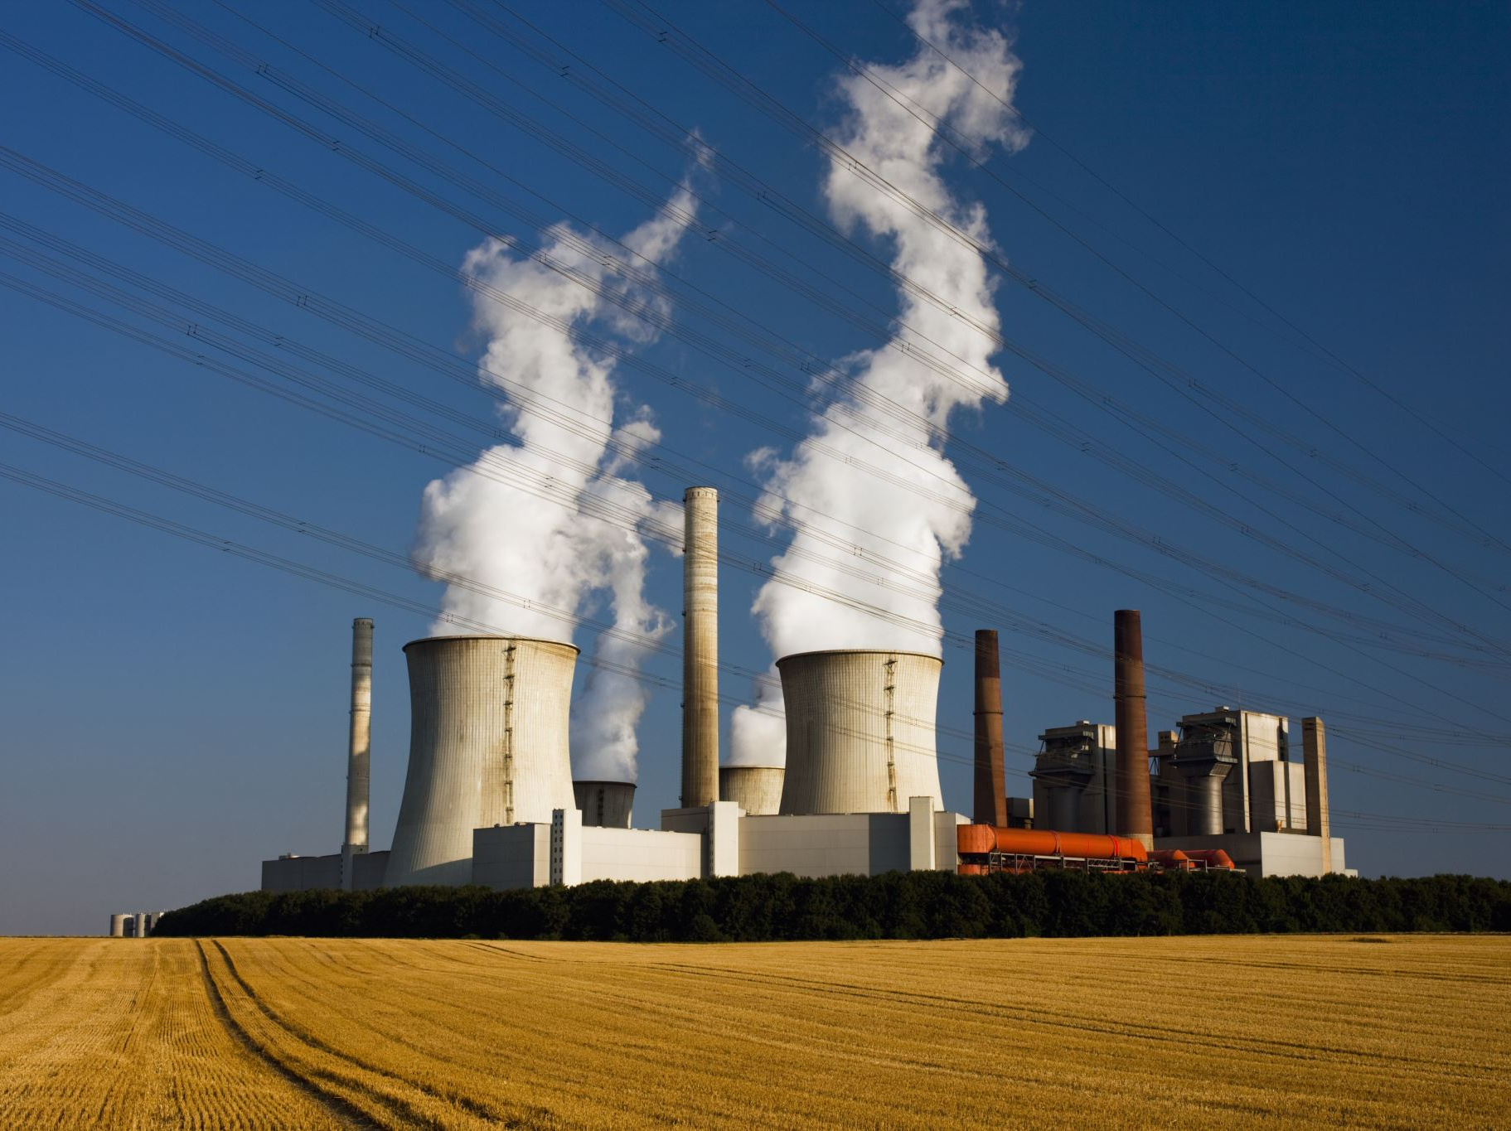
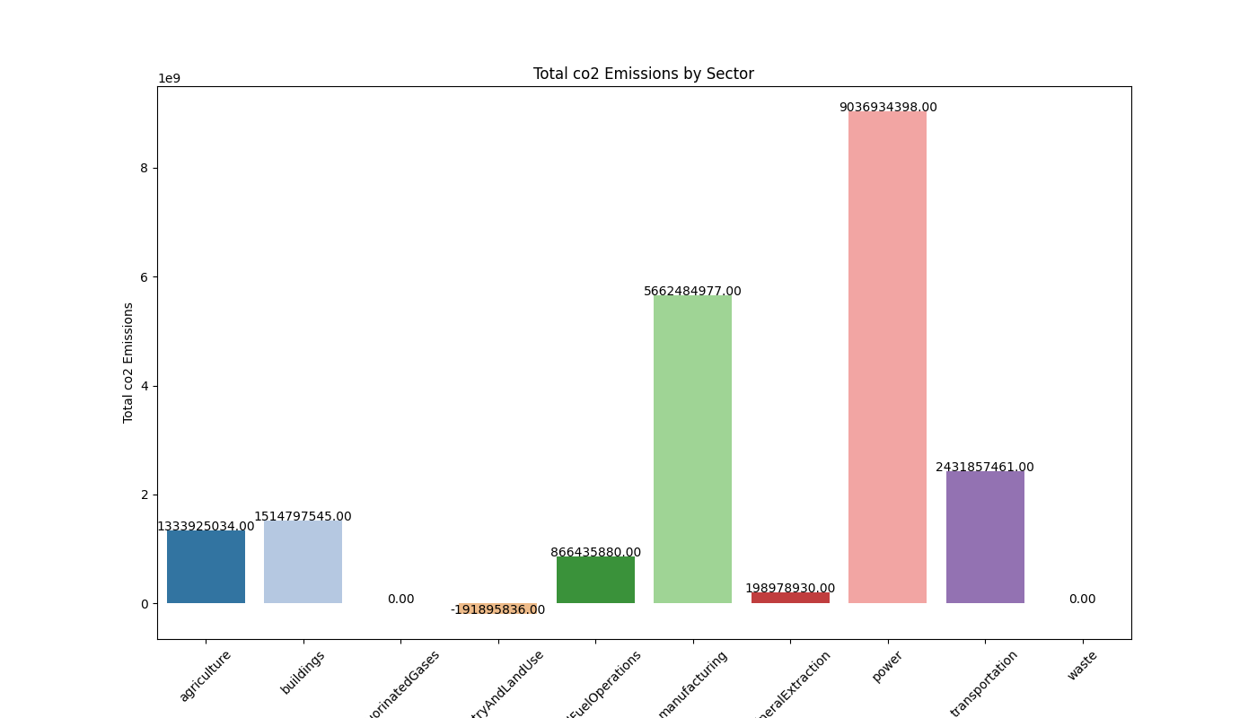

Total co2 emissions for each sector
Top 5
Power ~ 9.04 BmT
Manufacturing ~ 5.66 BmT
Transportation ~ 2.43 BmT
Buildings ~ 1.51 BmT
Agriculture ~ 1.33 BmT
Notes:
Upon performing analysis, this is an example graph we can avail. This graph shows the total amount of CO2 emitted by each sector in the dataset. Each sector is comprised of subsectors which further has entities which total up to make the entire sector’s emission. The total amounts are calculated from 2015 to 2022 which is the available data range on Climate Trace.

Slide 7

GHG – CH₄
Sector | 1st | 2nd | 3rd | 4th | Outlier
Agriculture | Enteric fermentation other | Enteric fermentation cattle feedlot | Rice cultivation | Manure management other | -
Buildings | Other onsite fuel usage | R&C onsite fuel usage | NO OTHER SUBSECTORS
Fluorinated gases | NO EMISSIONS
Forestry and land use | Water reservoirs | NO OTHER EMITTERS
Fossil fuel operations | Coal mining | Solid fuel transformation | Oil & gas production & transport | Other fossil fuel operations | -
Manufacturing | Petrochemicals | Other manufacturing | NO OTHER EMITTERS
Mineral extraction | NO EMISSIONS
Power | Other energy use | ONE OTHER SUBSECTOR AND NOT AN EMITTER
Transportation | Road transportation | Railways | NO OTHER EMITTERS
Waste | Wastewater treatment & discharge | Solid waste disposal | Biological treatment of solid waste & biogenic | Incineration & open burning of waste | -
Notes:
Upon performing analysis, this is an example table filled out. This table shows the total amount of CH4 emitted by each subsector from a sector in the dataset. Each of the subsectors is comprised of entities which total up to make the entire subsector’s emission. The total amounts are calculated from 2015 to 2022 which is the available data range on Climate Trace.
From the code we deduced the maximum emitting subsectors for each sector.

Slide 8
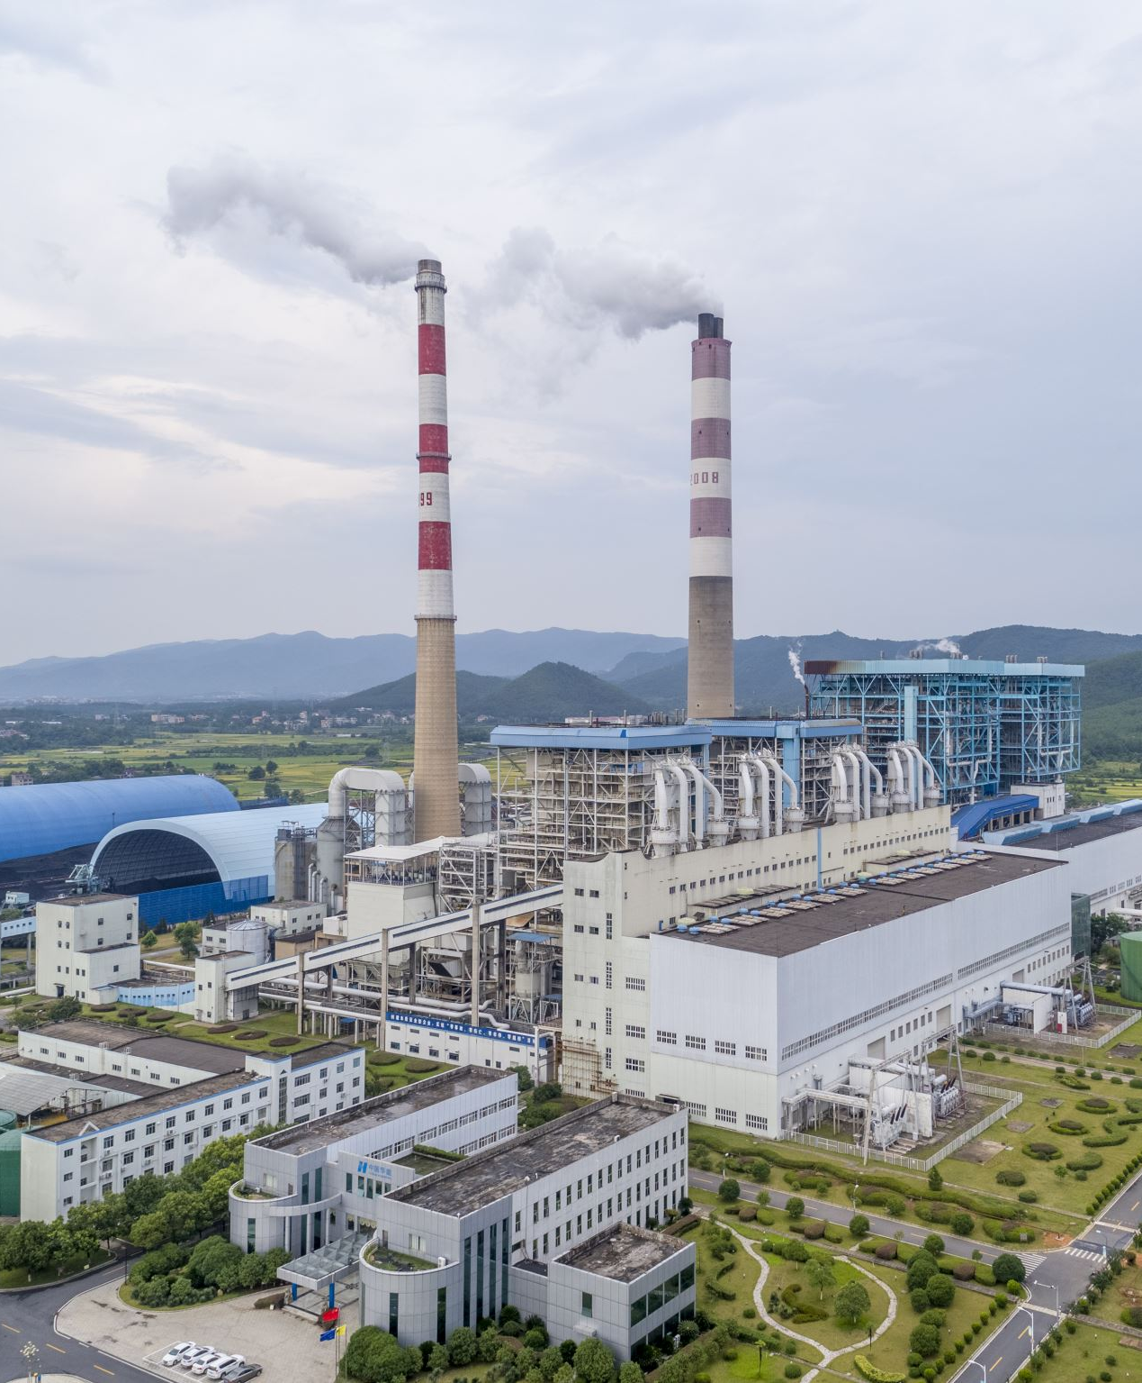

Points to note for GHG – CH₄
Agriculture – major emitters of ch4, almost all subsectors emit ch4.
Buildings – other onsite fuel usage emit more than regular residential & commercial usage.
Fluorinated gases – do not emit ch4.
Forestry and land use – only water reservoirs are emitting ch4 – why?
Fossil fuel operations – coal mining and solid fuel transformation emit most methane.
Manufacturing – petrochemicals emit the most methane, along with other non generic manufacturing that do.
Mineral extraction – do not emit ch4.
Power – other energy uses emit ch4, generation of electricity does not emit ch4.
Transportation – road transportation is major source of ch4 from this sector.
Waste – all subsectors emit ch4; maximum from wastewater treatment and discharge.
Notes:
Some observations for the sub-sectoral emissions analysis.

Slide 9
Example: entities polluting from electricity generation (Power sector)
source_id | source_name | source_type | subsector | year | gas | emissions_quantity | geometry_ref
25450481 | <unknown plant name> | gas, oil | electricity-generation | 2019 | ch4 | 0.0 | trace_76.378_9.9722
25450210 | Nellore power station | coal | electricity-generation | 2021 | ch4 | 0.0 | trace_79.9869_14.4906
25451508 | Neyveli Thermal Power Station II | coal | electricity-generation | 2021 | ch4 | 0.0 | trace_79.4739_11.5925
25451508 | Neyveli Thermal Power Station II | coal | electricity-generation | 2020 | ch4 | 0.0 | trace_79.4739_11.5925
25451489 | Vindhyachal power station | coal | electricity-generation | 2022 | co2 | 25361000.0 | trace_82.6719_24.0983
25453453 | Mundra Thermal Power Project (Adani) | coal | electricity-generation | 2022 | co2 | 24616000.0 | trace_69.5535_22.8235
25451489 | Vindhyachal power station | coal | electricity-generation | 2021 | co2 | 23603000.0 | trace_82.6719_24.0983
25451489 | Vindhyachal power station | coal | electricity-generation | 2019 | co2 | 22939000.0 | trace_82.6719_24.0983
25451489 | Vindhyachal power station | coal | electricity-generation | 2022 | co2e_100yr | 25361000.0 | trace_82.6719_24.0983
25453453 | Mundra Thermal Power Project (Adani) | coal | electricity-generation | 2022 | co2e_100yr | 24616000.0 | trace_69.5535_22.8235
25451489 | Vindhyachal power station | coal | electricity-generation | 2021 | co2e_100yr | 23603000.0 | trace_82.6719_24.0983
25451489 | Vindhyachal power station | coal | electricity-generation | 2019 | co2e_100yr | 22939000.0 | trace_82.6719_24.0983
25451489 | Vindhyachal power station | coal | electricity-generation | 2022 | co2e_20yr | 25361000.0 | trace_82.6719_24.0983
25453453 | Mundra Thermal Power Project (Adani) | coal | electricity-generation | 2022 | co2e_20yr | 24616000.0 | trace_69.5535_22.8235
25451489 | Vindhyachal power station | coal | electricity-generation | 2021 | co2e_20yr | 23603000.0 | trace_82.6719_24.0983
25451489 | Vindhyachal power station | coal | electricity-generation | 2019 | co2e_20yr | 22939000.0 | trace_82.6719_24.0983
25450481 | <unknown plant name> | gas, oil | electricity-generation | 2019 | n2o | 0.0 | trace_76.378_9.9722
25450210 | Nellore power station | coal | electricity-generation | 2021 | n2o | 0.0 | trace_79.9869_14.4906
25451508 | Neyveli Thermal Power Station II | coal | electricity-generation | 2021 | n2o | 0.0 | trace_79.4739_11.5925
25451508 | Neyveli Thermal Power Station II | coal | electricity-generation | 2020 | n2o | 0.0 | trace_79.4739_11.5925
Notes:
Upon performing analysis, this is an example table filled out. This table shows the total amount of CH4 emitted by each subsector from a sector in the dataset. Each of the subsectors is comprised of entities which total up to make the entire subsector’s emission. The total amounts are calculated from 2015 to 2022 which is the available data range on Climate Trace.
From the code we deduced the maximum emitting subsectors for each sector.

Slide 10

Insights
Opinion: Considering the big picture for India, for any greenhouse gas, if a public policy is strict enough towards and followed by major polluters of that gas in any sector, the small-scale polluters will also show a decline in emissions under the fear of them being the next targets for change.
Carbon dioxide (CO₂)
From before, we saw that the Power sector transcends the carbon dioxide emissions in India. More specifically, industries and power grids for electricity generation emit much of the carbon dioxide we have in the atmosphere. Much of India’s electricity generation is still done by thermal plants where fossil fuels are burnt.
Other non-generic manufactured items are seeing increase in carbon emissions rather than mass produced generic items.
Road transportation is contributing to not just CO₂, as well as other GHGs, and over the longer horizons building up to a high metric.
Methane (CH₄)
Methane emission from agriculture are seen from many areas across India from different sub-sector processes, although the major ones being – enteric fermentation of cattle feedlot and other types, along with the cultivation of rice.
Wastewater treatment and discharges have to be taken under notice whether the processes are being done successfully or not. The improper treatment of wastewater has also impacted water reservoirs (forestry and land use), make these water bodies contributors to the GHG emissions of India.
Fossil fuel inclusive operations are also on the rise where coal mining (for electricity generation later-on), is also massively needed and both the processes towards electricity generation are emitting different GHGs.
Nitrous oxide (N₂O)
Although India’s Nitrous oxide reading are well below the readings of carbon dioxide and methane, it is also a GHG and must be considered thoroughly.
The use of synthetic fertilizer and some other common soil emissions in our agricultural lands are contributing mostly to our N₂O emissions.
Wastewater is not just a polluter with methane with also with this GHG.

Slide 11
Google Earth Engine
Using satellite data available on google earth engine to replicate similar results from climate trace.

Slide 12
Objectives
Using GEE, build a multi-factor environmental analysis model.
Leverage the existing satellite data available to obtain accurate measurements.
Develop a program that automates the specified data collection and its processing.
Do the above while ensuring modularity for adaptable analysis.
Establish a cost-effective data solution to keep track of critical environmental factors affecting India (project scope as of now).

Slide 13
Data (Satellite Data used)
Sentinel-5P (COPERNICUS/S5P/OFFL/L3_CH4)
Data Used: Methane (CH₄) concentration (CH4_column_volume_mixing_ratio_dry_air)
Purpose: Assess air quality by measuring average methane levels in the target area.
Sentinel-5P (COPERNICUS/S5P/OFFL/L3_NO2)
Data Used: Nitrogen Dioxide (NO₂) concentration (tropospheric_NO2_column_number_density)
Purpose: Evaluate air quality by calculating the mean NO₂ concentration, which indicates pollution levels.
MODIS (MODIS/006/MCD12Q1)
Data Used: Land Cover (LC_Type1)
Purpose: Analyze land use and cover type to understand the distribution of natural landscapes, urban areas, and agricultural land.
Landsat 8 Surface Reflectance (LANDSAT/LC08/C01/T1_SR)
Data Used: Reflectance Bands (B2, B3, B4)
Purpose: Measure water quality using visible bands to detect surface conditions, which can indicate pollution or algal presence.
MODIS Surface Temperature (MODIS/006/MOD11A1)
Data Used: Land Surface Temperature Day and Night (LST_Day_1km, LST_Night_1km)
Purpose: Calculate daily and nightly surface temperatures to monitor climate conditions.
MODIS Vegetation Indices (MODIS/006/MOD13A1)
Data Used: Normalized Difference Vegetation Index (NDVI)
Purpose: Evaluate vegetation health and productivity in the area, which reflects ecosystem vitality.
CHIRPS Daily Precipitation (UCSB-CHG/CHIRPS/DAILY)
Data Used: Daily Precipitation (precipitation)
Purpose: Measure total precipitation in the region to analyze rainfall patterns, which affect soil moisture, crop health, and local hydrology.

Slide 14
Sample output (This is what our current program provides us for the current input location)
Hello from the Earth Engine servers!
Buffer Area (sq km): 314.1592653589793
Air Quality (CH4) Mean (ppbv): 1850.76
NO2 Mean (mol/m²): 0.000512
Land Cover Mode: 12
Water Quality Median B2 (Reflectance): 0.102
Water Quality Median B3 (Reflectance): 0.089
Water Quality Median B4 (Reflectance): 0.074
Air Temperature (Day) Mean (K*100): 30045.6
Surface Temperature (Night) Mean (K*100): 29321.2
NDVI Mean: 0.42
Total Precipitation (mm): 780.5

Slide 15
Observations
From our program and its subsequent output, given the specified coordinates and buffer area size, we can obtain the following data:
1. The mean air quality (CH4 - methane based) in ppbv
1850.76 ppbv (parts per billion by volume) indicates the average concentration of methane in the air over the specified area and period.
Higher levels of CH₄ can indicate pollution sources like industrial emissions or agriculture. The value gives insight into greenhouse gas levels, which impact climate change.
2. The mean NO2 (nitrogen dioxide) levels in mol/m²
The mean concentration of 0.000512 mol/m² shows the average amount of NO₂ in the atmosphere over the area.
NO₂ is a significant air pollutant affecting human health and contributes to smog formation and acid rain.
3. The land cover mode
This value indicates the most common type of land cover (or "mode") in the specified area, based on a land cover classification scheme.
Each number represents a specific land type (e.g., 12 might indicate wetlands or urban areas, depending on the classification used).
This helps in understanding dominant land use, which affects ecosystem health, urban planning, and environmental policies.
4. The water quality median B2 (Reflectance)
B2 (Blue band reflectance) in water bodies helps assess water clarity and quality.
0.102 reflectance indicates moderate clarity; high values suggest turbid or sediment-filled waters.
Blue reflectance is particularly sensitive to suspended particles, so lower values generally indicate clearer water.

Slide 16
OBSERVATIONS CONT.
5. The water quality median B3 (Reflectance)
B3 (Green band reflectance) is useful in distinguishing between water types and vegetation.
0.089 reflectance points to moderate visibility in the green wavelength, useful in studying suspended algae or chlorophyll concentration, both of which affect aquatic health.
6. The water quality median B4 (Reflectance)
B4 (Red band reflectance) often relates to the concentration of sediments and organic matter in water.
0.074 reflectance indicates clearer water in the red spectrum, with low values often reflecting lower concentrations of sediments or pollutants.
7. The mean air temperature during the day in K*100
Mean daytime land surface temperature in Kelvin, represented as K*100 (so, 300.45 K or about 27.3°C).
This metric helps in understanding surface heat, which impacts ecosystems, urban heat islands, and local climate patterns.
8. The mean surface temperature at night in K*100
Mean nighttime land surface temperature in Kelvin (293.21 K or about 20.1°C).
Nighttime temperatures are key for understanding heat retention, cooling rates, and effects on local climates, especially in urban or densely vegetated areas.
9. The mean of the NDVI (Normalized Difference Vegetation Index)
NDVI (Normalized Difference Vegetation Index) is an indicator of vegetation health, with values ranging from -1 to +1.
A mean of 0.42 signifies moderately healthy vegetation, as higher values indicate denser, greener vegetation, while lower values show less vegetation or stressed areas.
10. The total precipitation in millimetres
780.5 mm represents the cumulative rainfall over the period for the specified geographical area.
Total precipitation impacts water resources, soil moisture, and ecosystem productivity and is a fundamental climate variable for any environmental analysis.

Slide 17
Evaluation
Comprehensive Environmental Analysis: We successfully analyzed multiple environmental factors, including air quality (CH4 levels), NO2 concentration, land cover, water quality, air and surface temperature, vegetation health (NDVI), and precipitation. This comprehensive approach aligns with the Climate Trace objective of capturing key environmental metrics in one model.
Efficient Data Access and Processing: Using Google Earth Engine allows for direct access to a vast, regularly updated collection of satellite imagery and geospatial datasets. This real-time and historical data access eliminates the need to manually gather and preprocess data from different sources, which supports faster, integrated analyses, similar to those that we accomplished with Climate Trace.
Automated Geographic and Temporal Filtering: GEE’s powerful filtering capabilities allow us to define geographic areas (e.g., a specific buffer radius around a point) and temporal ranges (e.g., yearly data) for each metric. This streamlined data extraction method mirrors Climate Trace’s approach of focusing on regional and time-specific trends.
Statistical Summarization of Metrics: By calculating means, modes, and sums, we derived meaningful summaries for each environmental variable within the defined region. This data reduction is vital for spotting trends and making comparisons, mirroring Climate Trace’s goal of creating a digestible profile for emissions and environmental factors.
Cross-Referencing Different Data Sources: GEE integrates multiple data sources (Sentinel-5P, MODIS, Landsat, CHIRPS), which we accessed within one framework. This combination provides a multi-source perspective on each environmental factor, strengthening the reliability of the analysis and aligning with Climate Trace's objective of leveraging multiple data streams.
Adaptable, Scalable Analysis Framework: The program’s modular design allows us to easily adapt or scale the analysis to different regions, timeframes, or additional environmental indicators as needed, much like Climate Trace's objective of scalable emissions tracking.
Publicly Accessible and Cost-Effective: Since GEE provides access to data without the need for extensive infrastructure or subscriptions, it’s a cost-effective solution for ongoing environmental monitoring. This is crucial for maintaining a high-frequency analysis similar to Climate Trace’s model, ensuring the project remains accessible and sustainable.

Slide 18

What can we do?
Policy and Regulation: The increasing trend in greenhouse gas emissions calls for stricter environmental regulations and policies targeting high-emission sectors such as agriculture and transportation.
Sector-Specific Strategies: Identifying high-emission subsectors within major sectors can help in devising targeted strategies for emission reduction. For example, focusing on reducing emissions from 'synthetic-fertilizer-application' within the agricultural sector.
Resource Allocation: Understanding which sectors and subsectors contribute most to emissions can guide the allocation of resources and efforts towards the most impactful areas for emission reductions.

Slide 19
More for this project
Impact Assessment: Assess the impact of specific interventions or policies implemented over the years on emission trends.
1
Comparative Studies: Compare the emission trends and sectoral contributions with other countries to understand India's relative position and progress in emission reduction.
2
Predictive Modeling: Develop predictive models to forecast future emissions based on current trends and proposed policy changes, aiding in strategic planning and policy-making.
3

Slide 20

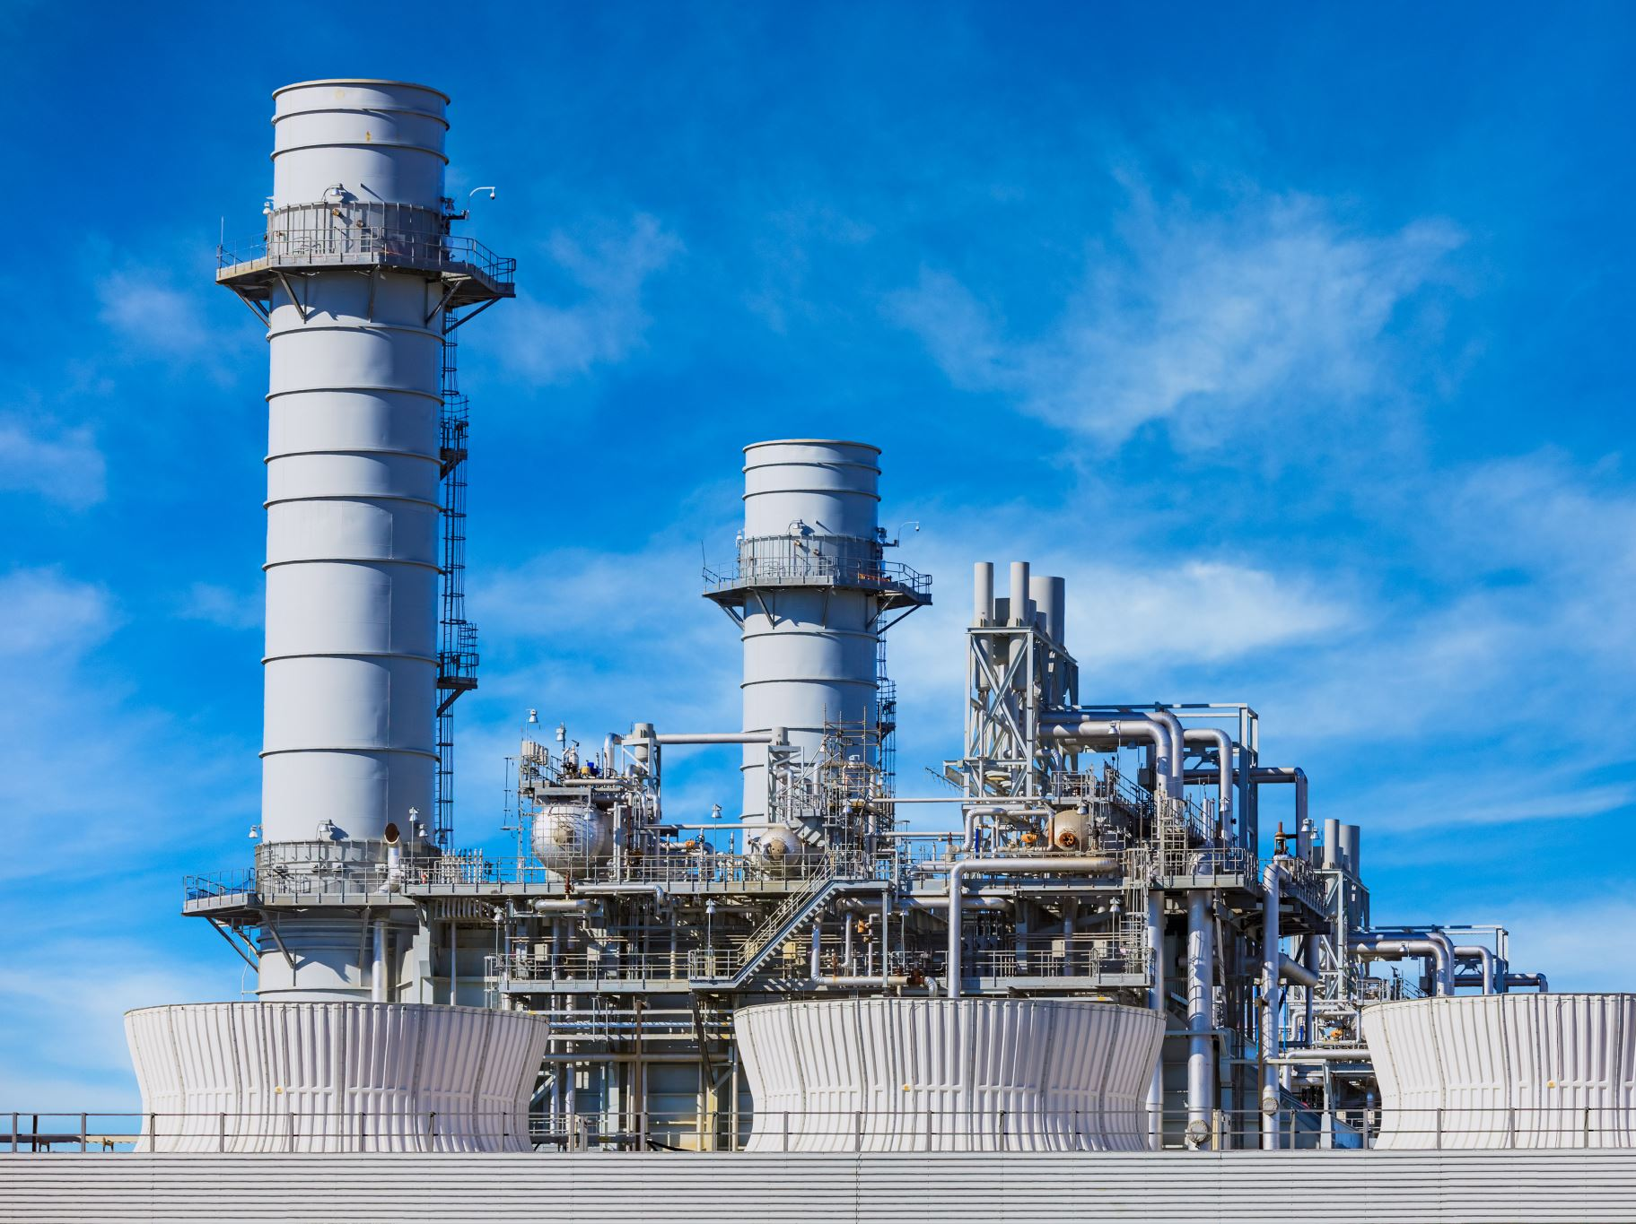
resources
Climate TRACE https://climatetrace.org/inventory?country=IND&year_from=2015&year_to=2022&gas=co2e100
Agriculture Background Image https://okcredit.in/blog/how-does-the-agriculture-industry-work/
Generation of Thermal Power from Raw Coal (Government of India) https://www.coal.nic.in/en/major-statistics/generation-of-thermal-power-from-raw-coal#:~:text=In%20India%2C%20power%20is%20generated,of%20the%20total%20power%20generation.
Greenhouse Gases, CO2, CO2e, and Carbon: What Do All These Terms Mean? (Brander, July 2023) https://ecometrica.com/assets/GHGs-CO2-CO2e-and-Carbon-What-Do-These-Mean-v2.1.pdf

